Slide 1

SUPPLIER USER MANUAL
REGISTRATION

Slide 2
CONTENT
ADVANCED Supplier Registration Process
ARIBA Network Supplier Self Registration
Ariba Network Supplier Registration
ADVANCED Supplier Registration Forms
Additional Resources

Slide 3
ADVANCED Supplier Registration Process

Slide 4
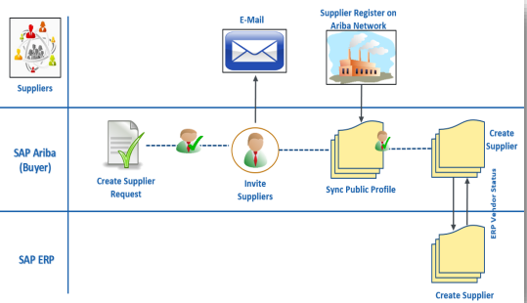
ADVANCED has implemented SAP Ariba Supplier Lifecycle and Performance for Supplier on boarding or Registration.
Buyer initiates supplier request by mentioning basic supplier details, after approval buyer can invite supplier for registration
Supplier will receive an email with link to access Ariba Network. Supplier needs to access Ariba Network, fills the registration questionnaire and submit the response.
After approval, supplier will get registered in Ariba

Slide 5

SAP Ariba Can Help You With...
Enhanced collaboration and the ability to manage your commercial relationship with us via one single digital platform
The ability to create, own and manage your digital Supplier Profile - enabling electronic trade with us and potentially other buyer organizations that are Ariba Network enabled
Greater visibility and transparency of the status of business transactions (e.g. Supplier Communications, Notifications), sourcing events and opportunities
Greater visibility of our end-to-end procurement process

Slide 6

Cost Implications
For a Supplier to conduct business with us via the 3 new SAP Ariba Modules, they will need the following :
A device that can access the internet via a browser (Desktop, Laptop or Tablet)
Suppliers incur no costs to:
create their supplier profile
create a new SAP Ariba Network Standard Account
participate in any sourcing event (including Registration Questionnaires)

Slide 7
ARIBA Network Supplier Self Registration

Slide 8
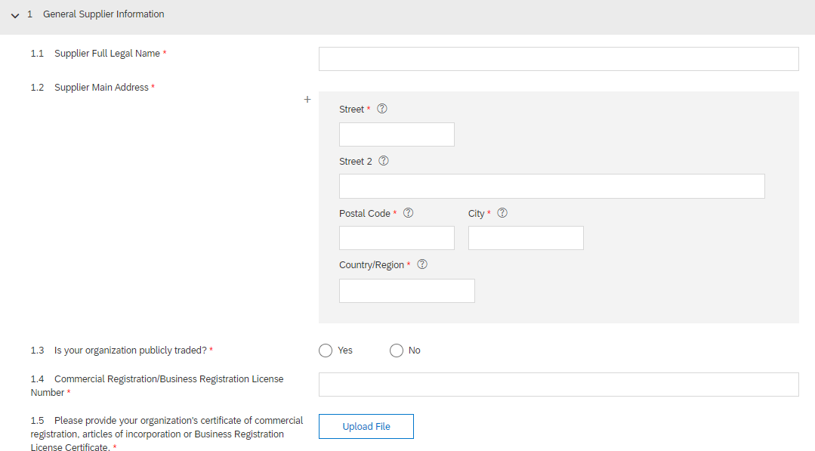
Self Registration URL:
http://Advanced.sourcing.mn2.ariba.com/ad/selfRegistration/_c_/C2
It will redirect to Advanced Supplier Self-Registration Request Form

Slide 9
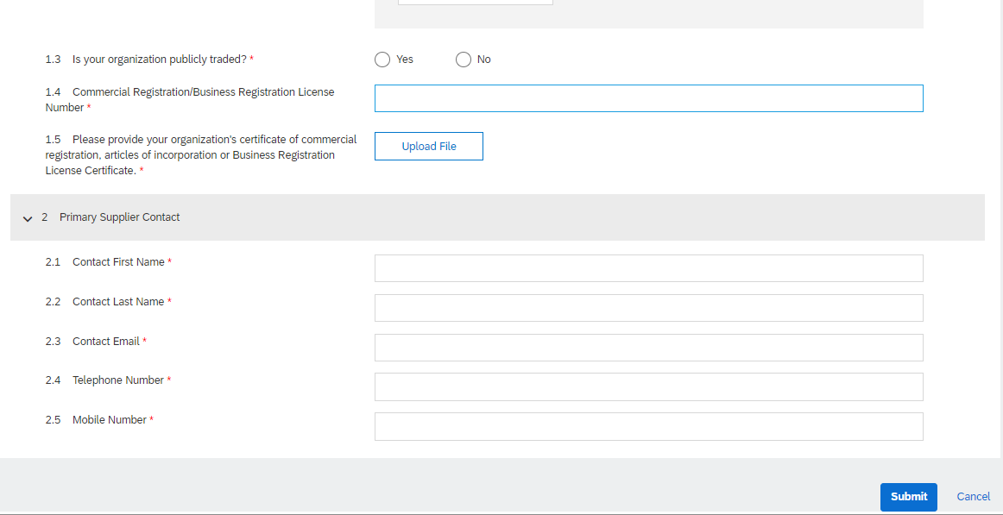
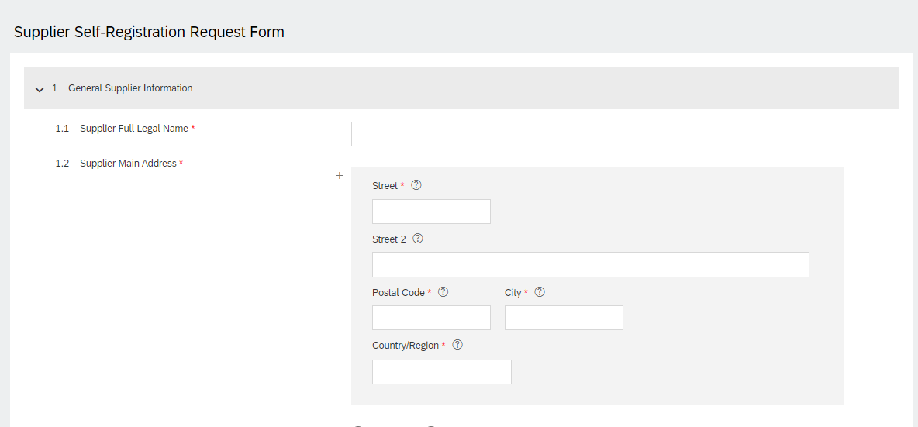
Please fill all the mandatory details related to your Organization
Please make sure to use email address of your company domain. Using Gmail , Yahoo domain email addresses will lead to rejection of supplier registration.
Fill the mandatory ​
details with asterisk (*)​

Slide 10
After filling all required and mandatory information click “Submit”​

Slide 11
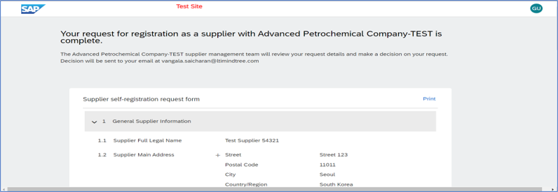
After “Submit” below confirmation will appear
Once Supplier Manager will approve the supplier self registration form.​ ​​

Slide 12
Ariba Network Supplier Registration

Slide 13
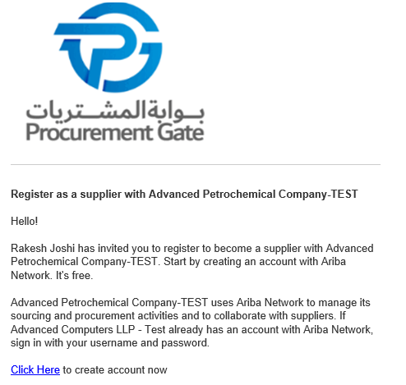
Supplier will receive an email on registered email id with link to access Ariba Network
Supplier needs to click on “Click Here” option highlighted in the email
Supplier will be redirected to Ariba Network login page

Slide 14
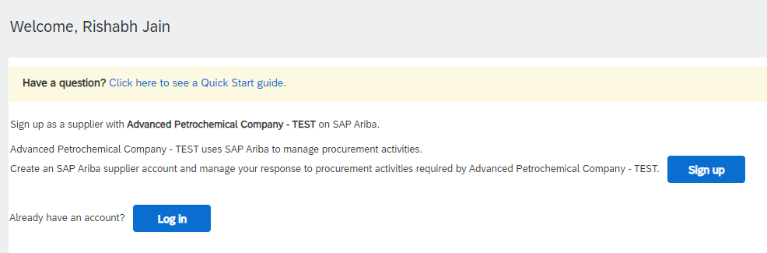
New Suppliers needs to Sign Up and set username and password
Suppliers having Ariba Network ID can directly login

Slide 15
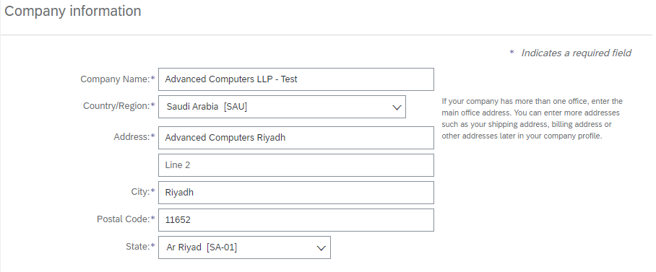
New Suppliers needs to fill the form with basic information
They can set username and password for future use
Email ID can set here for receiving all the emails related to Ariba Network

Slide 16
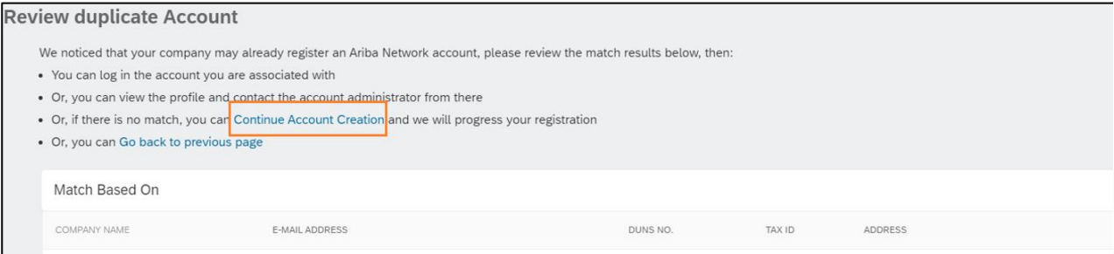
Suppliers can review if they already has Ariba Network account
If ‘Yes’, then they can cancel the sign up and login to Ariba Network directly
If ‘No’, then suppliers can continue to account creation and access Ariba Network

Slide 17
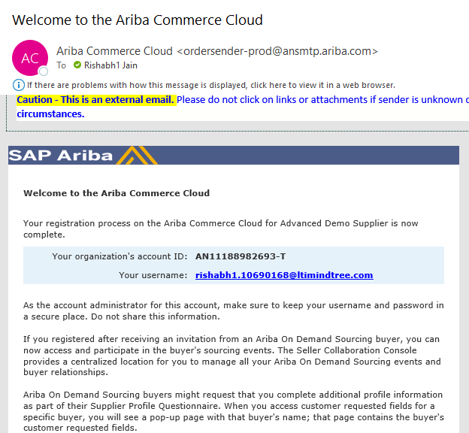
After successful account creation, supplier receives a welcome email from Ariba on their registered email address
Email contains supplier Ariba Network ID and username

Slide 18
ADVANCED Supplier Registration Forms

Slide 19
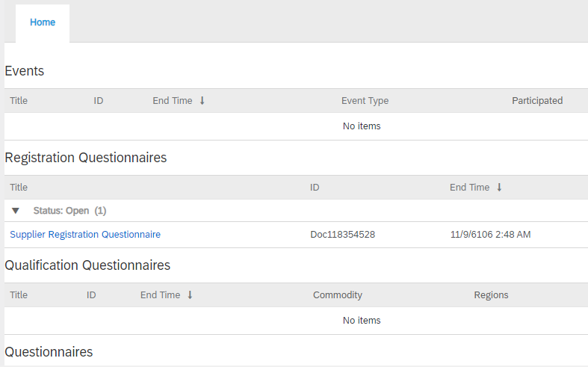
Registration Form
After login, on the homepage suppliers can see all the questionnaires
It will show completed as well as pending questionnaires
It shows questionnaire name, due date and status
Supplier needs to click on questionnaire to submit the response

Slide 20
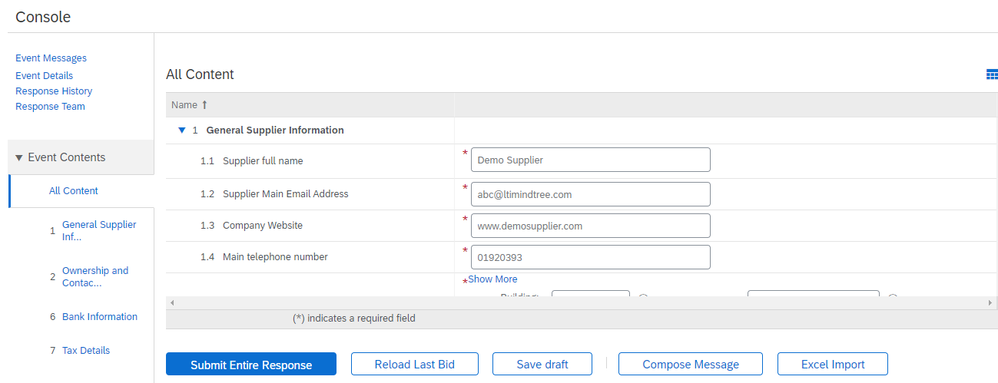
Registration Form
On the left side, it will have Questionnaire Sections which supplier needs to answer.
Supplier needs to answer and attach documents for all the mandatory questions
Please make sure to use email address of your company domain. Using Gmail , Yahoo domain email addresses will lead to rejection of supplier registration.
Mandatory question are marked with asterisk *

Slide 21
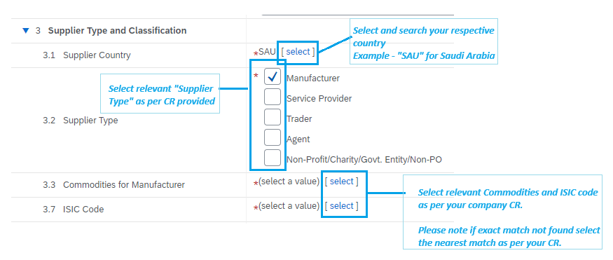
Important Information

Slide 22

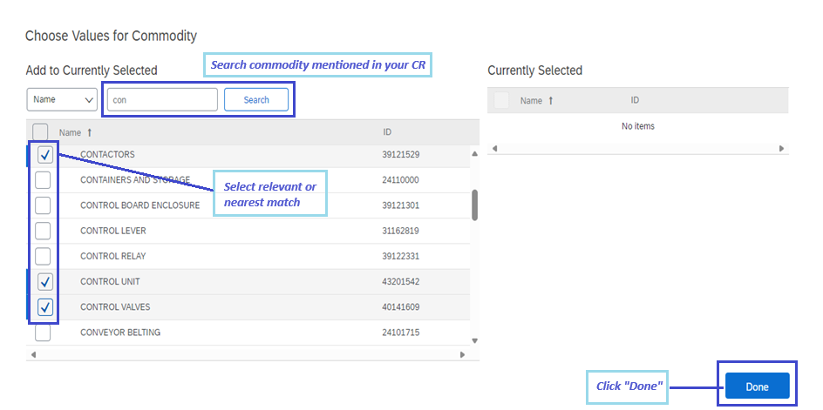
Commodities & ISIC Codes
1
Click “select” to choose commodities and ISIC codes
2
3
4

Slide 23
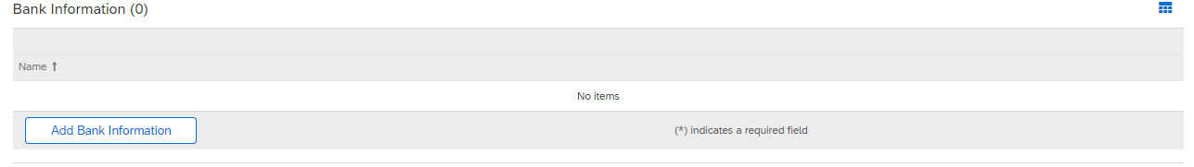
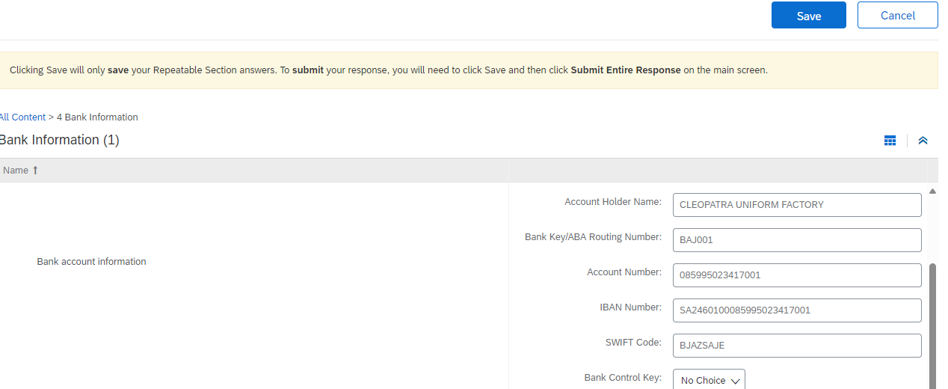
BANK & TAX INFORMATION
Supplier Bank Information and Tax Details are sections that you must click open to add details
Click on ‘Add Bank Information’ for bank details that you wish to add and then click on OK
Click on ‘Add Tax Details’ to add
You can add more than one bank details and tax detail.
For detail information regarding “Bank Details” please refer next slides.

Slide 24
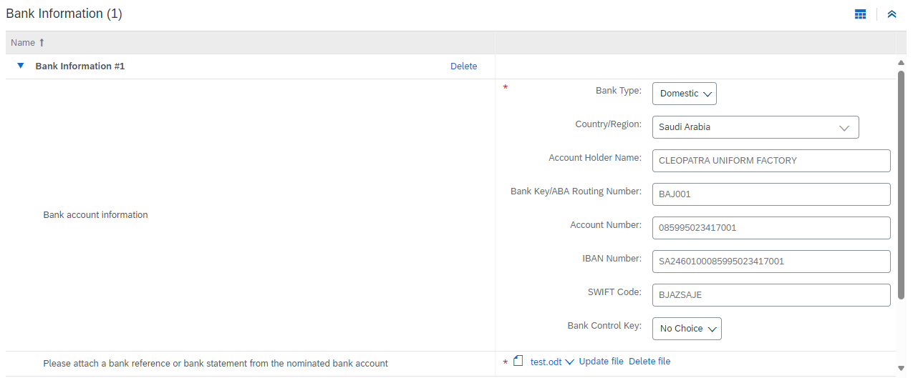
BANK INFORMATION
Bank Type – Select “Domestic” if bank is “Local” or else “Foreign”.
Country/Region – Update Bank Country
Account Holder Name – No special character allowed, and limit is up to 60 character
Bank Key/ABA Routing Number – Please refer excel file attached to find bank key. (refer next slide)
Account Number -- Update bank account number as per bank letter.
IBAN Number – Please refer bank letter issued by bank.
SWIFT Code – Please refer bank letter issued by bank.
Please attach a bank reference or bank statement from the nominated bank account – Attach bank letter with bank stamp

Slide 25
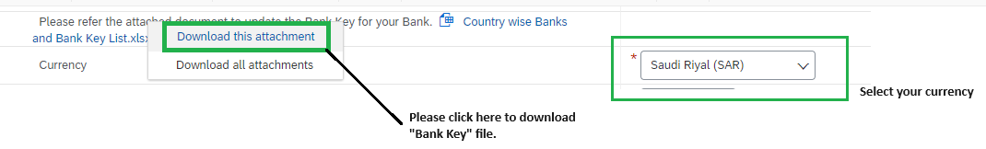
BANK INFORMATION
Country Wise Banks and Bank key list – Click on file and click “Download this attachment”.
Currency – Select currency from drop down

Slide 26
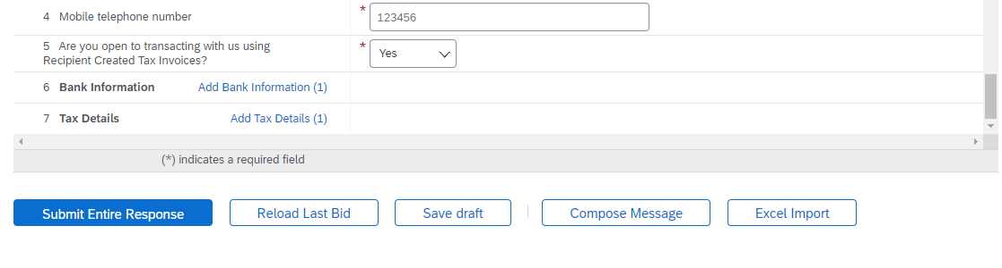
Suppliers can save the questionnaire response using “save draft” option
To reload the last answers
“Compose Message” option can be used to send a query to buyer, it will automatically send an email to buyer
Supplier can import the response using “Excel Import” option
Supplier can click on “Submit Entire Response” to submit the questionnaire once all the questions are answered

Slide 27
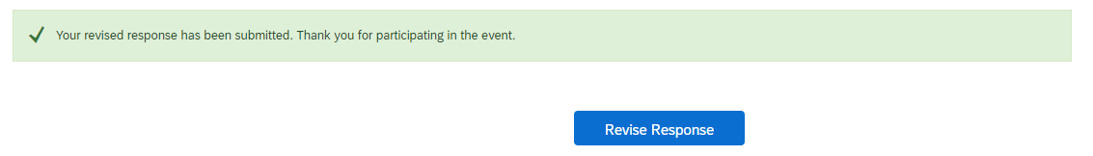
Supplier can edit the response which they have submitted previously
Suppliers needs to use “Revise Response” option to edit and resubmit the response

Slide 28
Useful Links
Ariba Network Hot Issues and FAQs – https://connect.ariba.com/anfaq.htm
Ariba Cloud Statistics – http://trust.ariba.com
  Detailed information and latest notifications about product issues and planned downtime - if any - during a given day
Ariba Discovery - http://www.ariba.com/solutions/discovery-for-suppliers.cfm
Ariba Network Notifications - http://netstat.ariba.com
  Information about downtime, new releases and new features

Slide 29


